Slide 1
Lecture 1
THE KARNAUGH MAP
CME 2003
Digital Logic
Şerife SUNGUN

Slide 2
THE KARNAUGH MAP
The purpose of a Karnaugh map is to simplify a Boolean expression.
similar to a truth table because it presents all of the possible values of input variables and the resulting output for each value.
Karnaugh map is an array of cells in which each cell represents a binary value of the input.
    For three variables, the number of cells is 2 ³ = 8.
DEU CSE
Şerife SUNGUN

Slide 3
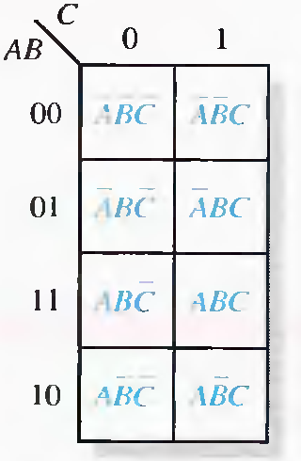
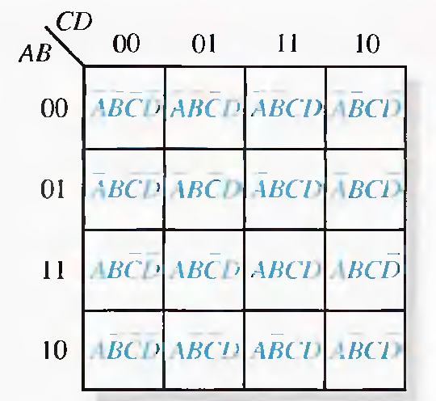
… Karnaugh Map
The 3-Variable Karnaugh Map
The 4-Variable Karnaugh Map
DEU CSE
Şerife SUNGUN

Slide 4
Cell Adjacency
only a single-variable change between adjacent cells.
  In the 3-variable map adjacent cells of the 010 cell are 000, 011 and 110.
Physically, each cell is adjacent to the cells that are immediately next to it on any of its four sides.
  A cell is not adjacent to the cells that diagonally touch any of its corners.
DEU CSE
Şerife SUNGUN

Slide 5
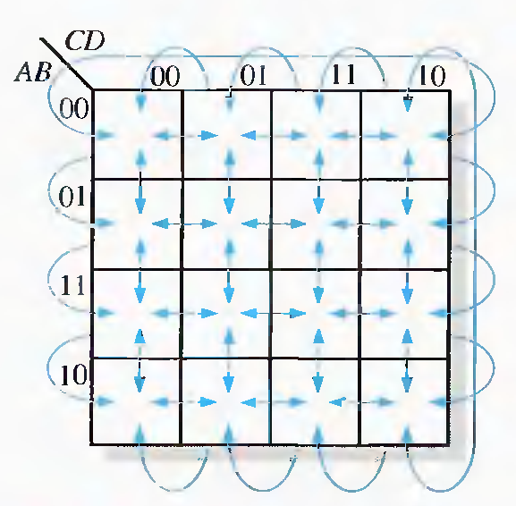
Cell Adjacency
DEU CSE
Şerife SUNGUN

Slide 6
KARNAUGH MAP SOP MINIMIZATION
Mapping a Standard SOP Expression
  Step 1. Determine the binary value of each product term in the standard SOP expression.
  Step 2. As each product term is evaluated, place a 1 on the Karnaugh map in the cell having the same value as the product term.
DEU CSE
Şerife SUNGUN

Slide 7
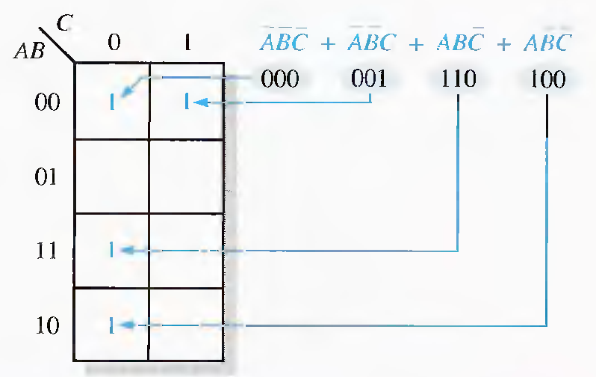
Example
DEU CSE
Şerife SUNGUN

Slide 8
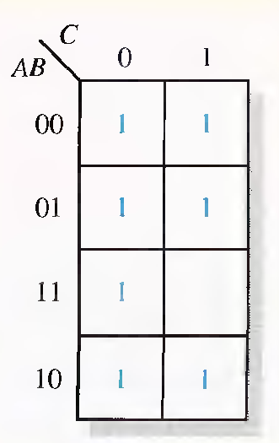
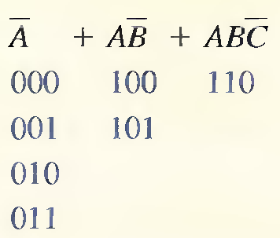
Mapping a Nonstandard SOP Expression
A Boolean expression must first be in standard form
DEU CSE
Şerife SUNGUN

Slide 9
Karnaugh Map Simplification of SOP Expressions
Minimization: The process that results in an expression containing the fewest possible terms with the fewest possible variables
A group must contain either 1, 2, 4, 8, or 16 cells, which are all powers of two.
Each cell in a group must be adjacent to one or more cells in that same group. but all cells in the group do not have to be adjacent to each other.
Always include the largest possible number of 1 s in a group in accordance with rule 1.
DEU CSE
Şerife SUNGUN

Slide 10
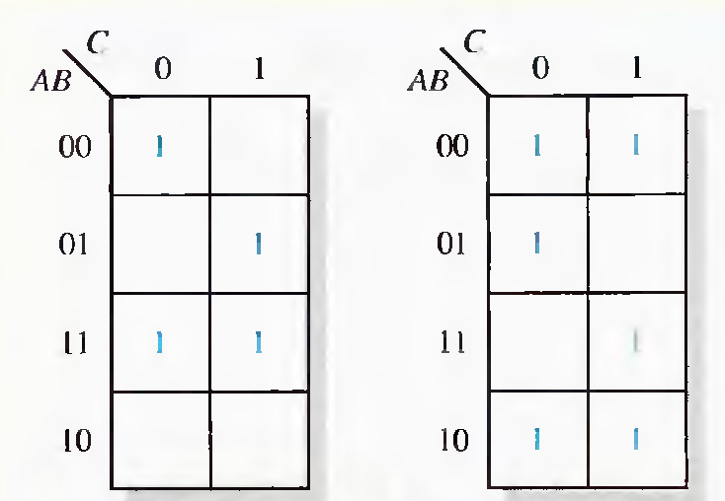
Example
DEU CSE
Şerife SUNGUN

Slide 11
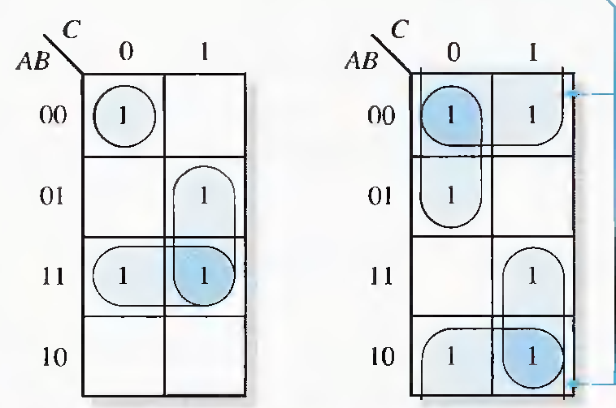
Example
DEU CSE
Şerife SUNGUN

Slide 12
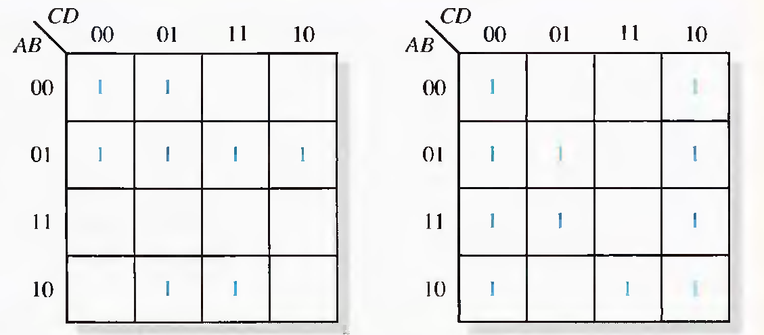
Example
DEU CSE
Şerife SUNGUN

Slide 13
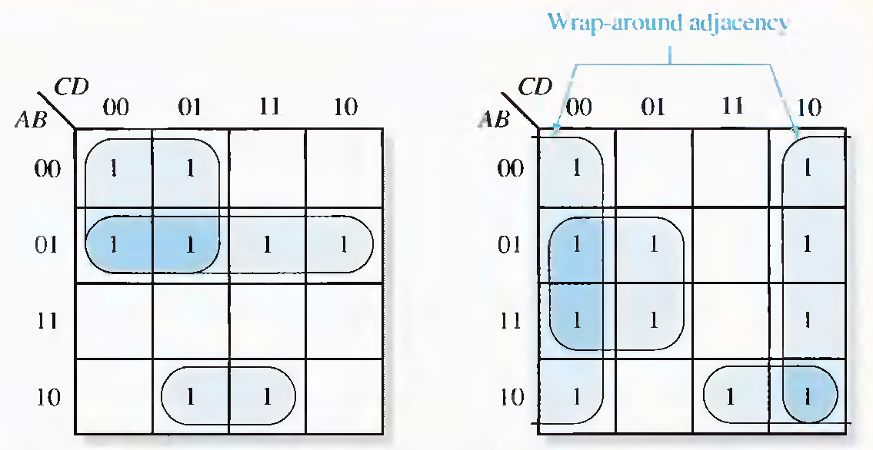
Example
DEU CSE
Şerife SUNGUN

Slide 14
Determining the Minimum SOP Expression from the Map
Group the cells that have 1 s.
Determine the minimum product term for each group.
When all the minimum product terms are derived from the Karnaugh map, they are summed to form the minimum SOP expression.
DEU CSE
Şerife SUNGUN

Slide 15

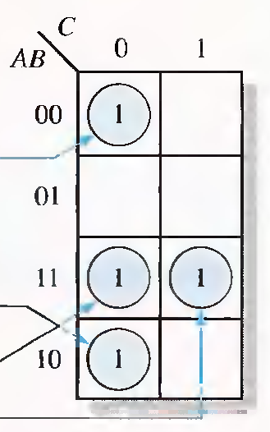
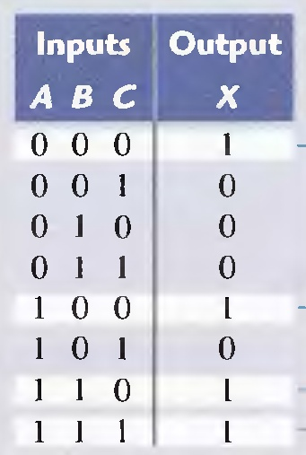
Mapping Directly from a Truth Table
DEU CSE
Şerife SUNGUN

Slide 16
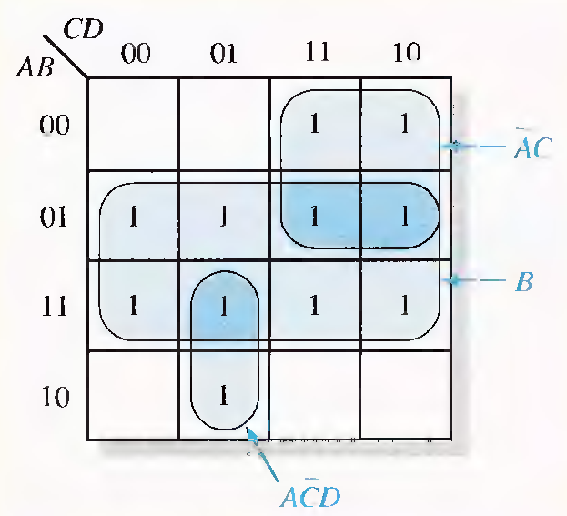

Example
DEU CSE
Şerife SUNGUN

Slide 17
"Don't Care" Conditions
Sometimes a situation arises in which some input variable combinations are not allowed.
  For example, in the BCD code, there are six invalid combinations: 1010, 1011, 1100, 1101, 1110, and 1111.
  Since these unallowed states will never occur in an application involving the BCD code, they can be treated as "don't care" terms with respect to their effect on the output.
"don't care" terms either a 1 or a 0 may be assigned to the output.
DEU CSE
Şerife SUNGUN

Slide 18
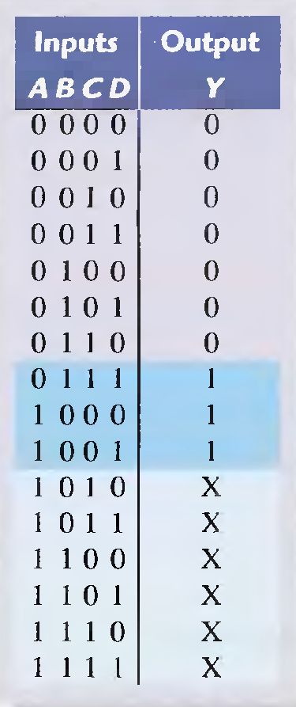
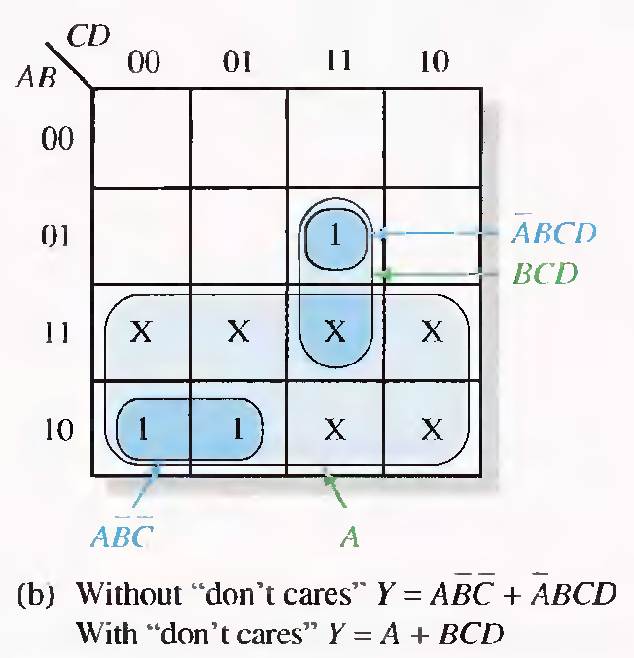
Example
DEU CSE
Şerife SUNGUN

Slide 19
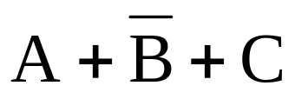
Mapping a Standard POS Expression
Step 1. Determine the binary value of each sum term in the standard POS expression.This is the binary value that makes the term equal to 0.
Step 2. As each sum term is evaluated, place a 0 on the Karnaugh map in the coresponding cell.
Example:
for the sum term , a 0 goes in the 0 1 0 cell on a 3-variable map.
DEU CSE
Şerife SUNGUN

Slide 20
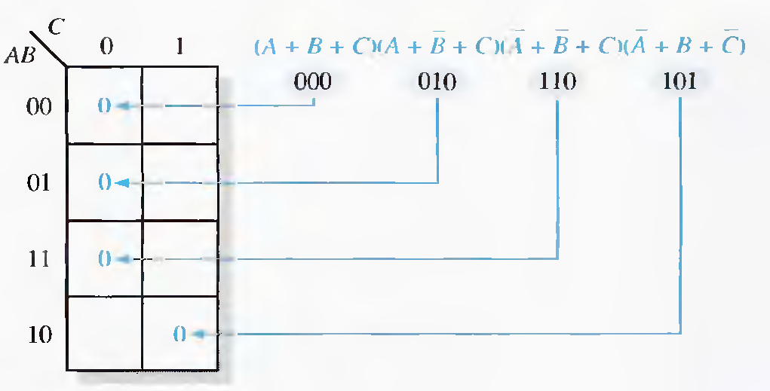
Example
DEU CSE
Şerife SUNGUN

Slide 21
Karnaugh Map Simplification of POS Expressions
minimizing a POS expression is basically the same as for an SOP expression except that you group 0s to produce minimum sum terms instead of grouping 1s to produce minimum product terms.
DEU CSE
Şerife SUNGUN

Slide 22
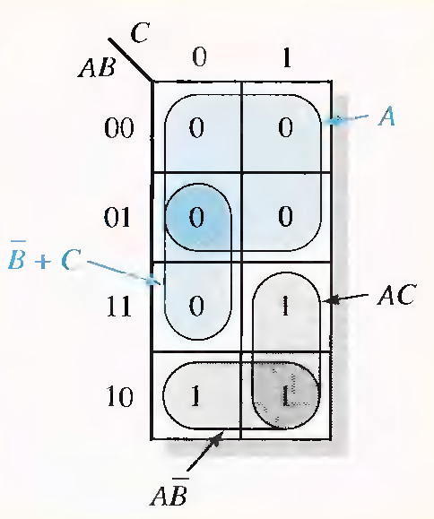

Example
Use a Karnaugh map to minimize the following standard POS expression:
The combinations of binary values of the expression are
Minimum SOP
Minimum POS
DEU CSE
Şerife SUNGUN

Slide 23
Converting Between POS and SOP Using the Karnaugh Map
For a POS expression, all the cells that do not contain 0s contain 1s, from which the SOP expression is derived.
For an SOP expression, all the cells that do not contain 1s contain 0s, from which the POS expression is derived.
DEU CSE
Şerife SUNGUN

Slide 24
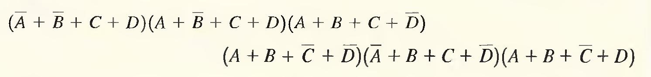
Example
Using a Karnaugh map, convert the following standard POS expression into
  a minimum POS expression,
  a standard SOP expression,
  a minimum SOP expression.
DEU CSE
Şerife SUNGUN

Slide 25
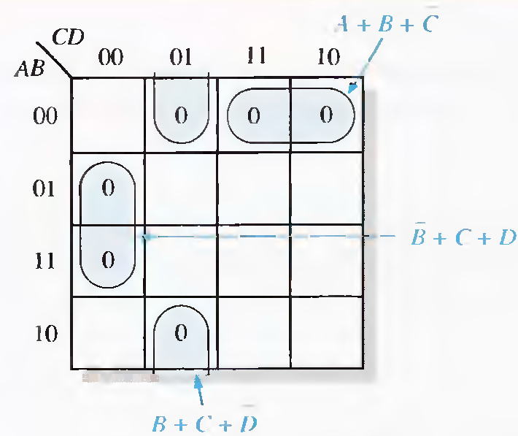
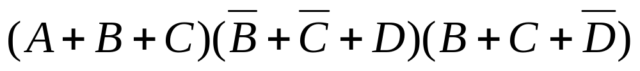
a) Minimum POS
DEU CSE
Şerife SUNGUN

Slide 26
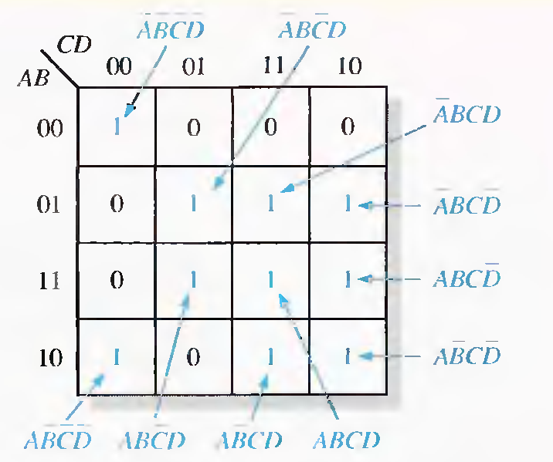

b) standard SOP
DEU CSE
Şerife SUNGUN

Slide 27
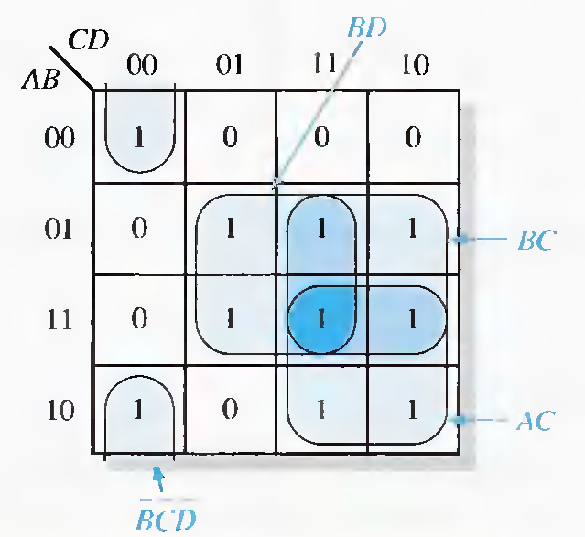

c) minimum SOP
DEU CSE
Şerife SUNGUN

Slide 28
FIVE-VARIABLE KARNAUGH MAPS
A Kamaugh map for five variables (ABCDE) can be constructed using two 4-variable maps with which you are already familiar.
Each map contains 16 cells with all combinations of variables B,C,D, and E.
One map is for A = 0 and the other is for A = 1,
DEU CSE
Şerife SUNGUN

Slide 29
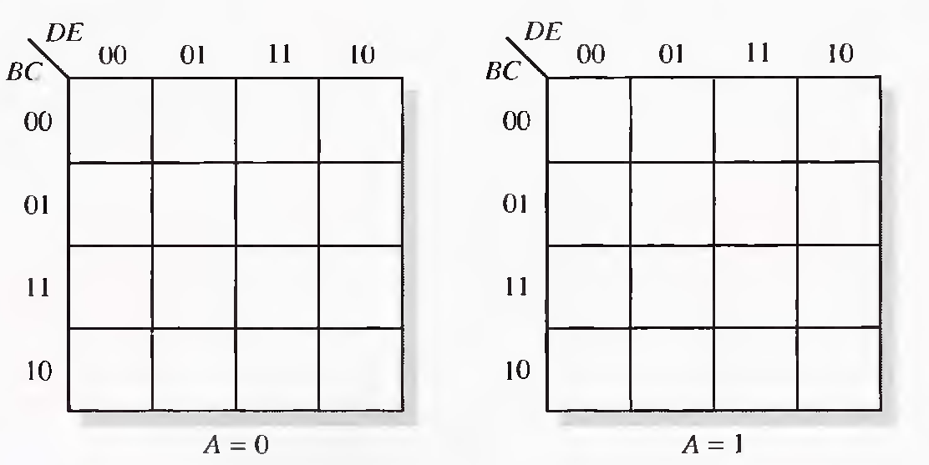
… FIVE-VARIABLE KARNAUGH MAPS
DEU CSE
Şerife SUNGUN

Slide 30
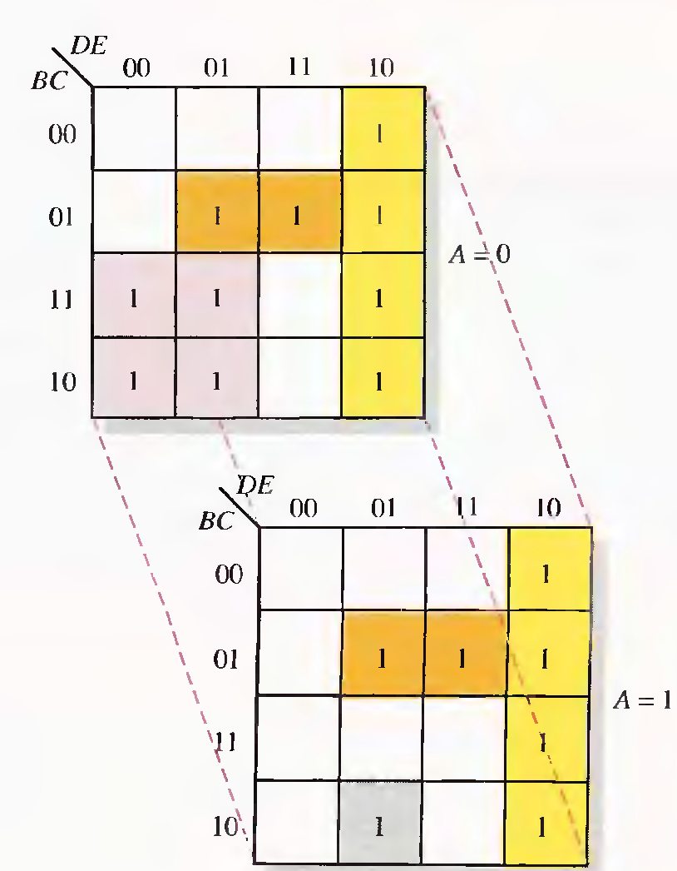
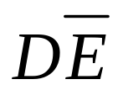
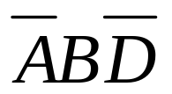
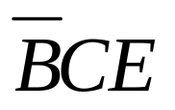

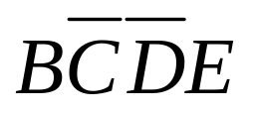
Cell Adjacencies
DEU CSE
Şerife SUNGUN

Slide 31
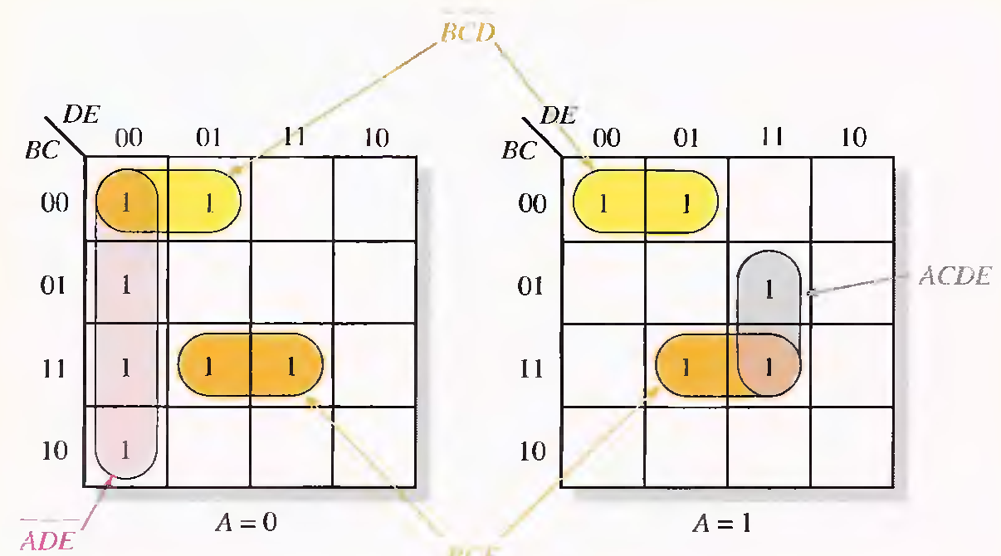
Example
Use a Karnaugh map to minimize the following standard SOP S-variable expression:
DEU CSE
Şerife SUNGUN

Slide 32
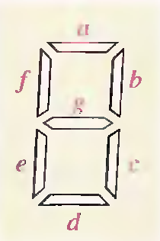
The 7-Segment Display
These displays are used with logic circuits that decode a binary coded decimal (BCD) number and activate the appropriate digits on the display.
LED Displays consist of light-emitting diodes (LEDs)
DEU CSE
Şerife SUNGUN

Slide 33
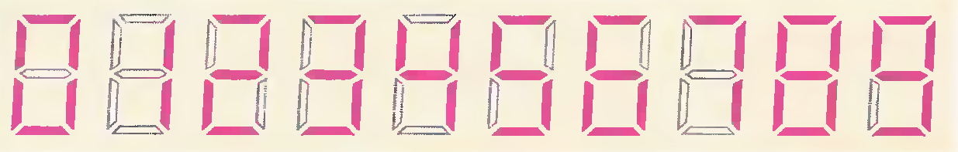
.. The 7-Segment LED Display
the common-anode:
  When a LOW is applied to a segment input, the LED is turned on.
the common-cathode:
  When a HIGH is applied to a segment input, the LED is turned on
DEU CSE
Şerife SUNGUN

Slide 34
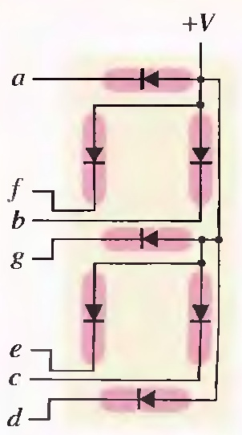
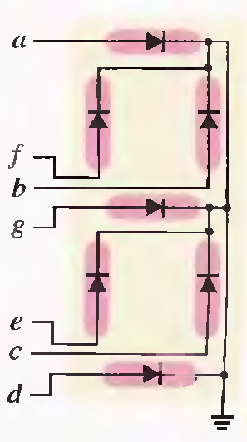
Common-anode
Common-cathode
LOW
HIGH
DEU CSE
Şerife SUNGUN

Slide 35
Segment Logic
Each segment is used for various decimal digits, but no one segment is used for all ten digits.
Each segment must be activated by its own decoding circuit that detects the occurrence of any of the numbers in which the segment is used.
DEU CSE
Şerife SUNGUN

Slide 36
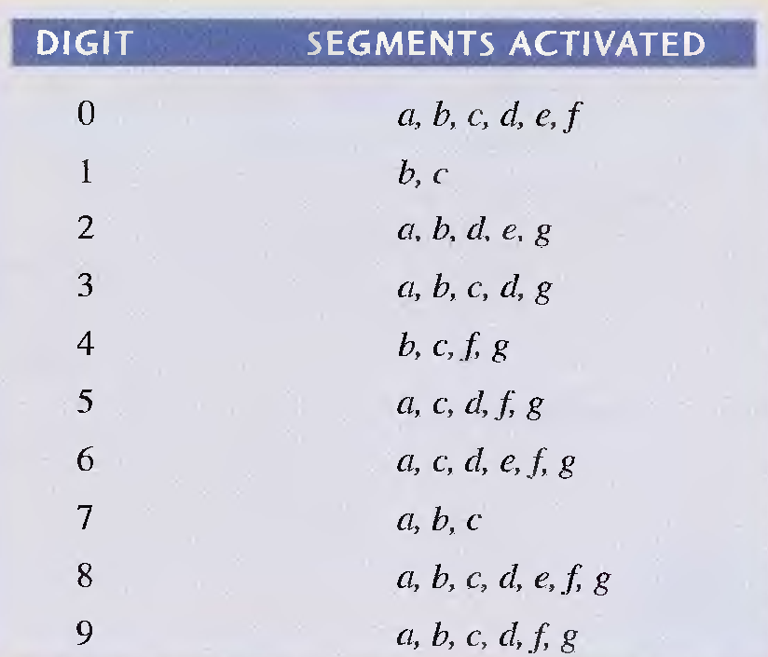
…Segment Logic
DEU CSE
Şerife SUNGUN

Slide 37
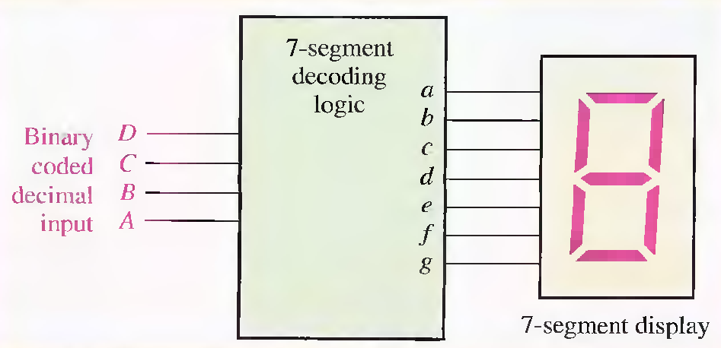
Block diagram of 7-segment logic and display.
DEU CSE
Şerife SUNGUN

Slide 38
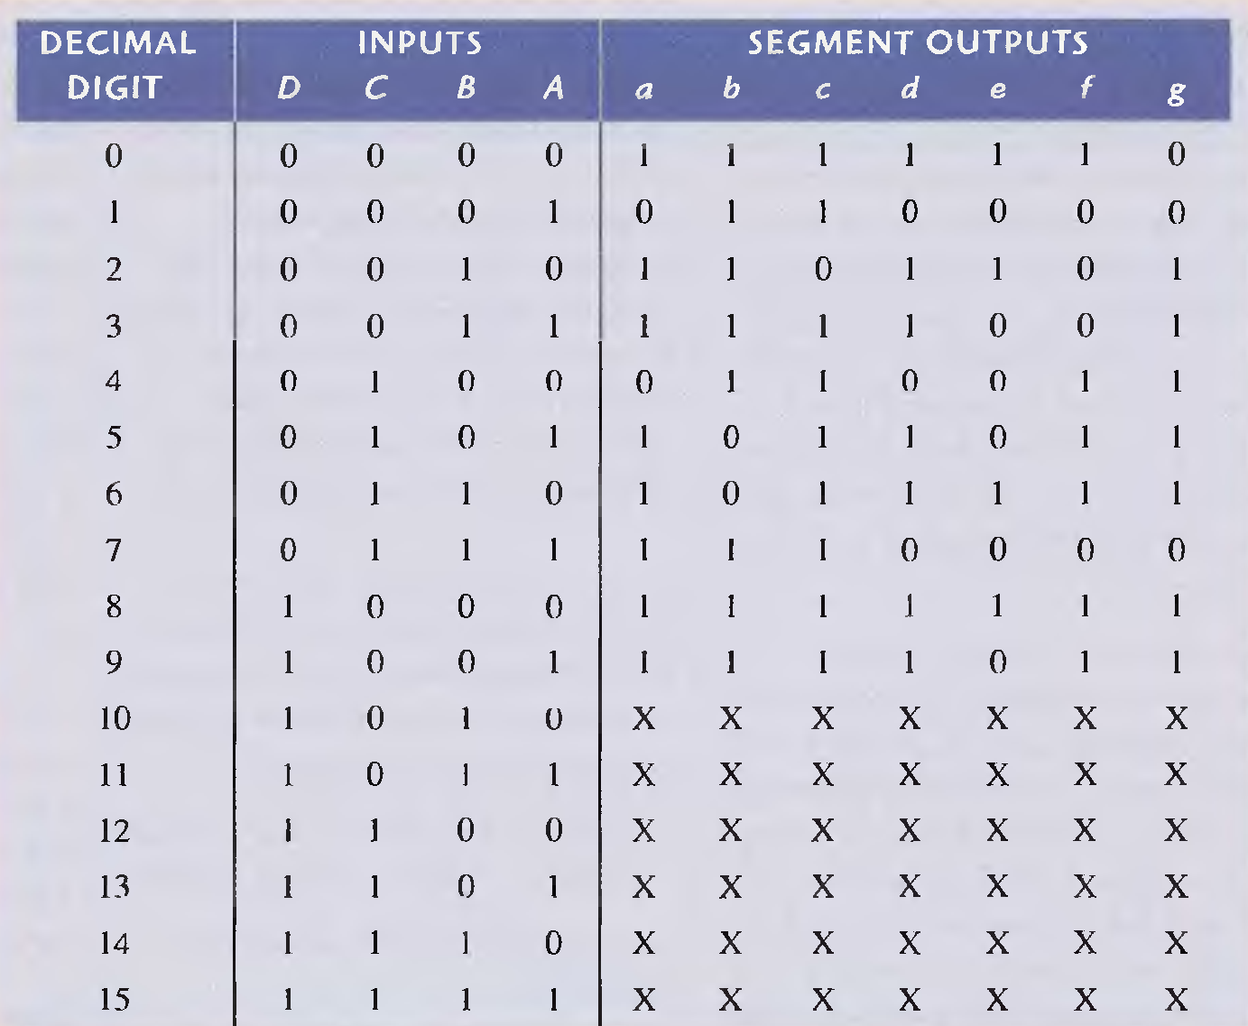
Truth table for 7-segment logic
DEU CSE
Şerife SUNGUN

Slide 39
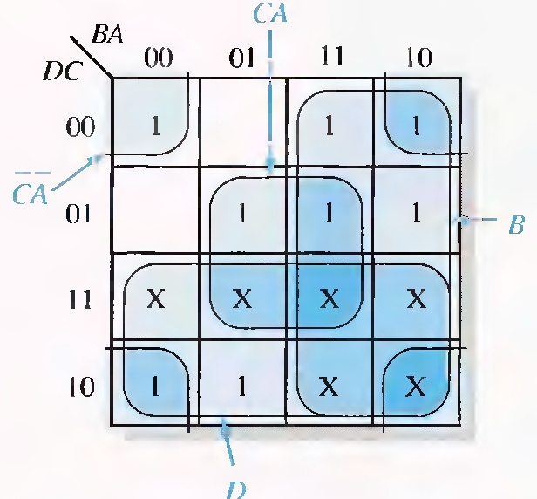
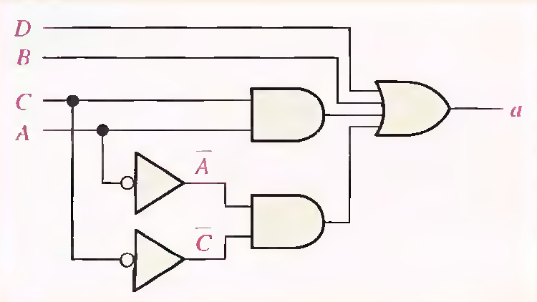
DEU CSE
Şerife SUNGUN

